Slide 1
Overview of the September 11th Victims and Needs
CONFIDENTIAL
United Way of New York City and the September 11th Fund
Board Meeting
November 8, 2001

Slide 2

AVAILABLE FUNDS FOR HUMAN VICTIMS
AS OF NOVEMBER 1
$ Millions; percent
General purpose
charitable funds
  Largely
  unrestricted funds
  Specific designation in most cases yet to be decided
Special purpose
charitable funds
  Funds restricted either to specific classes of victim or specific needs
100% = $16,200 million
$300 (1%)
$900
(6%)
$4,000
(25%)
Private insurance
  Claims by individuals to private insurance companies
~$11,000
(68%)
Government funds
and agencies
  Includes estimates of amount committed to date by federal, state, and local governments
Source: Robin Hood Foundation; FEMA; OMB; Hevesi report; Dow Jones Interactive; literature search

Slide 3
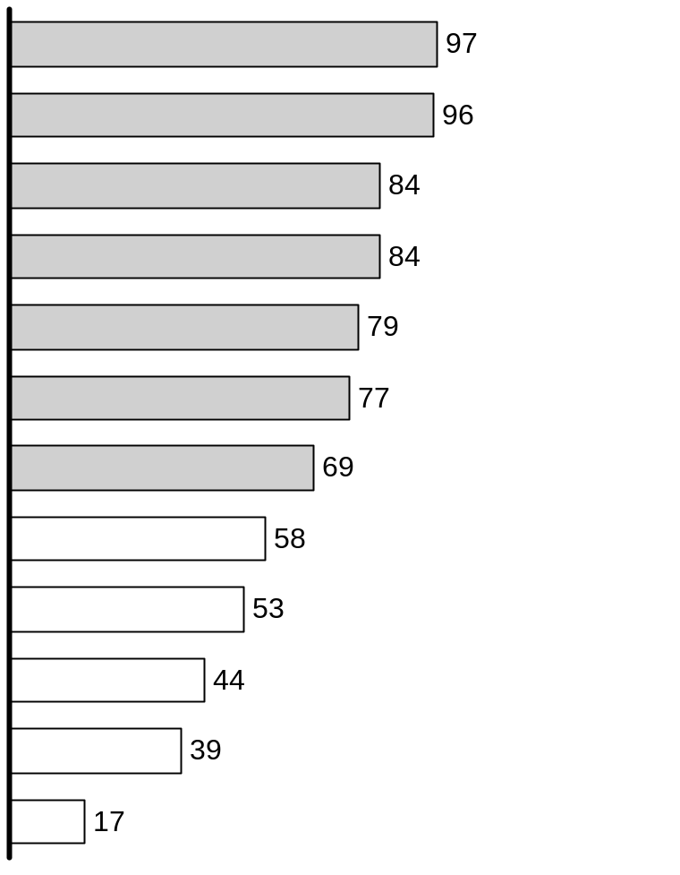
GENERAL PUBLIC EXPECTATIONS – WHICH VICTIMS SHOULD
RECEIVE SUPPORT?
Response >2/3
Respondents stating group should receive donor support*
Percent
Victim class
Subclass
Primary
Spouse and children of those who lost their lives
Suffered physical harm as result of direct attacks
Secondary
Displaced from home as result of collapse
Rescue workers involved in aftermath
Lost jobs in collapsed/evacuated buildings
Escaped from collapse and need support and counseling
Residents of affected areas who lost wages as result of attacks
Tertiary
Children in need of help in dealing with tragedy
All those in need of support or counseling
Respondents believe those directly affected by tragedy (e.g., at site of attacks, live/work on-site) should receive support
Those who suffered from hate crimes as result
of attacks
Lost business operations as direct result of attacks
Those afraid to continue to work at job
* Interviews were conducted with the general public and may not reflect the opinion of other donors
Source: Lightspeed online survey (10/1), n = 1,182 nationwide respondents
Notes:
Survey respondents believe those directly affected by tragedy should receive support.

Slide 4
DONOR EXPECTATIONS – FOUNDATIONS, CORPORATIONS,
AND HIGH NET WORTH INDIVIDUALS
“We split a $3 million donation equally between 3 funds in order to address 3 different types of victims. We gave to the Twin Towers Fund for firefighters and police, the Star Ledger Fund for NJ victims, and the September 11th Fund for everyone else.”
“We are confident that you are best suited to provide immediate support to the most trusted non-profit organizations that are serving the most urgent needs.”
Foundations
“This is a time that requires our community to join together . . .
To help sustain those who have suffered most and to help rebuild our city. We have great respect for the expertise that your organizations bring to this most difficult task.”
“We contributed to you because we trust your expertise. We’re confident you’ll put the funds to their best use, however you choose to distribute them.”
Corporations
“I worry about the ‘invisible victim’. The September 11th Fund is casting a wider net than just the high publicity areas, which in my mind is a positive. If I only wanted to donate money to firefighters,
I would have donated to the Fireman’s Fund.”
“I know you will get the victim classes right. My concern is that with so many funds out there, certain groups will get too much while others will be overlooked.”
High net worth
individuals
Source: Phone interviews
Notes:
Major donors gave to September 11th Fun for both expertise and experience with non-profits and to ensure equity among victim classes.

Slide 5
PRELIMINARY NEEDS ASSESSMENT – CLASSES OF VICTIMS
Definition
Those who were physically harmed at the World Trade Center or Pentagon as a result of the attacks on September 11th and their families
Primary
Those who did not suffer physical harm but were at WTC/Pentagon or had economic interests there
Secondary
Tertiary
All others adversely affected by the events of September 11th
Notes:
To begin assessing needs, we classified victims into three categories based on levels of victimization.

Slide 6
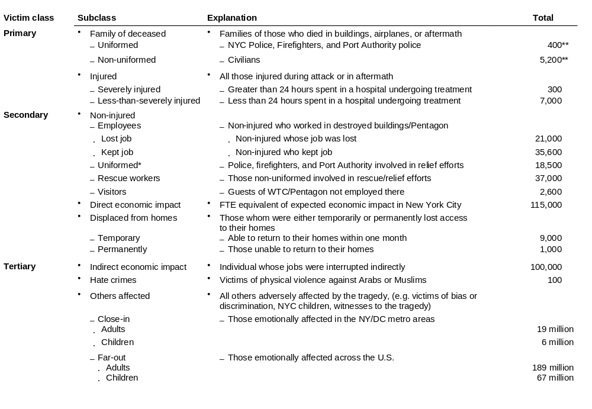
SIZING VICTIM CLASSES – HUMAN VICTIMS
ESTIMATES
* Includes police, firefighter, and Port Authority only
** While this reflects Police department estimates, sources continue to look into these figures (e.g. NY Times survey). This figure is a “moving target”
Source: CNN; NY Post; Pentagon Public Affairs; FDNY/NYPD Affairs; FEMA; Hevesi report; Fiscal Policy Institute; BPC association; FBI hate crimes statistics; NY Times; McKinsey analysis
Notes:
To estimate the human victim population, victim classes were broken down into discrete sub-classes.

Slide 7
CATEGORIES OF NEED
Immediate relief
Compensation
Renew and rebuild
Definition
  Helping victims meet pressing, basic needs such as shelter, food, clothing, and immediate healthcare
  Offering financial remuneration for losses experienced during or directly related to the September 11th attacks
  Providing support to victims, families, and their communities in order to help them cope with the medium and long-term effects of the events of September 11th
Notes:
In classifying types of needs, three main categories emerged across all victim classes covering short-term immediate relief financial compensation and long-term support for victims.

Slide 8
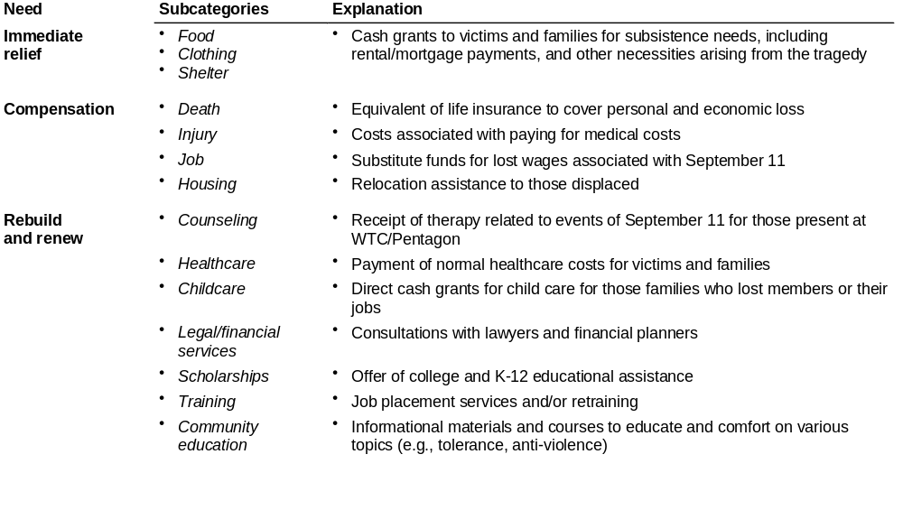
CATEGORIES OF NEED – HUMAN VICTIMS
Notes:
For human victims, needs range from food and shelter in the short-term to counseling and job training in the long-term.

Slide 9
ESTIMATED GAPS IN MEETING HUMAN NEEDS*
ESTIMATED
Extent of gap
September 11th Fund’s support of Safe Horizons has helped to meet immediate needs
<20% met
20-70% somewhat
>70% substantially
Needs
$ Millions
Number of victims
Immediate relief
Compensation
Rebuild & renew
  13,000
  100
  400
  500
Primary
  200
  15,900
  2,900
  200
  900
  2,100
Secondary
Victim class
  240,000
  500
  1,800
  5,100
  200
  400
Tertiary
  281,000,000
  N/A
  500
  2,500
Immediate needs likely to be met irrespective of estimates
Compensation needs likely to be met except in highest estimate
Rebuilding and renewal likely to be substantially unmet
* Identified gaps based only on funds with specific designations. This does not included general funds such as September 11th Fund.
Source: McKinsey analysis
Notes:
For human victims, largest funding gap seen in renewal and rebuilding for secondary and tertiary victims.

Slide 10
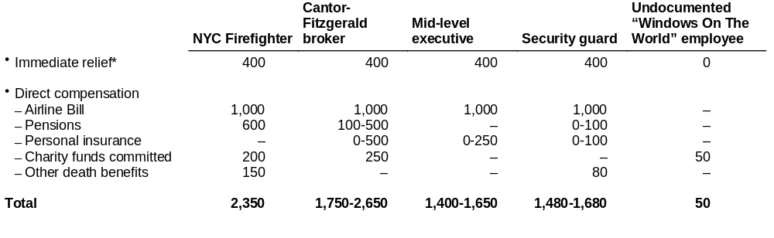
CASH COMPENSATION DISPARITY
$ Thousands
For victims who died in the WTC/Pentagon, direct compensation excluding the airline bill could range between $50,000-$2.65 million
* Immediate relief includes, but is not limited to, funds provided by the following agencies – Crime Victims Board ($30,000), Social Security ($160,000 NPV or 30 years), Workers Comp. Board ($180,000 lump sum), and FEMA ($14,000). Other non-governmental entities (e.g., September 11th Fund through Safe Horizons) have provided emergency funds to individuals, including undocumented workers, on a case-by-case basis
Source: CVB; SSB; WCB; FEMA; NY Times; Hevesi report; McKinsey analysis
Notes:
Even within these groups, large funding disparities could occur based on individual circumstances.

Slide 11
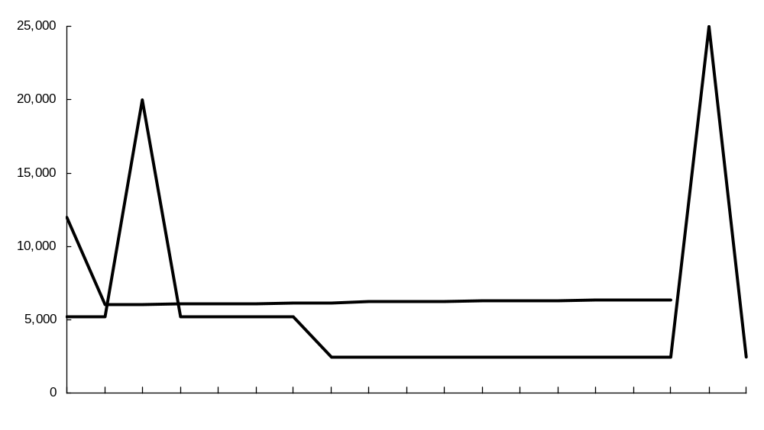
POTENTIAL FINANCIAL GAP OVER TIME FOR
PRIMARY INDIVIDUAL VICTIMS
ILLUSTRATIVE
Potential gap
For deceased or severely injured victims
Dollars per month
FEMA support for burial, legal, and material costs
Over 85% of survey respondents view interest-free loans as appropriate response to government funding time gap
Compensation*** from federal airline bill uncertain in timing or amount
Airline bill ~ $1 million per victim or more
End of crime victim board support
Family expenses**
Immediate relief***
October 2001
April 2002
October
April 2003
October
April 2004
October
April 2005
October
* Family expenses have been defined from a cash flow perspective. Since the average U.S. household does not save any money, we assumed that income equaled expenses. Accordingly to the NYC Comptroller report, the average salary for a WTC employee was $100,000, which we grew at 5% annually and tax affected at 31%.
** Immediate relief as supplied by CVB ($2,400 per month), SSA ($1,400 per month), worker’s compensation ($1,600 per month), and FEMA ($14,400). Does not include any private insurance or charity.
*** While the federal government has promised swift distribution of compensation, historical experience does not support that claim.
Source: McKinsey analysis
Notes:
Despite numerous funding sources, primary victims could see large gaps due to timing of funding availability (from former p. 30).

Slide 12
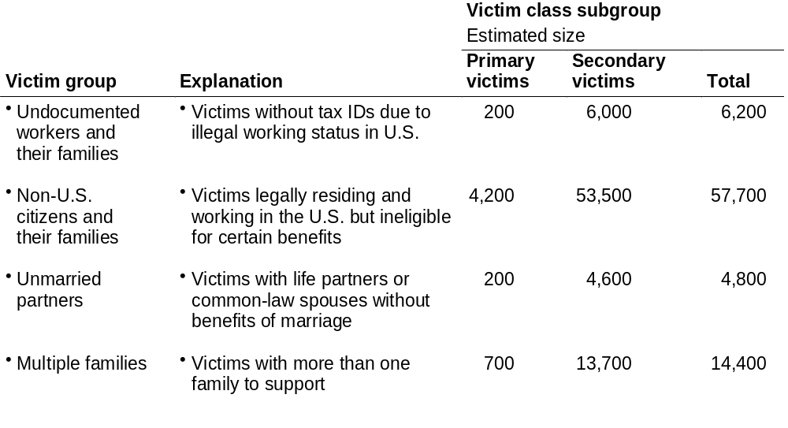
VICTIM GROUPS WITH POTENTIALLY UNDERSERVED NEEDS
While overall needs of victim classes may be satisfied, large subgroups within these broad classes may
“fall through the cracks”
Note: Number different from September 11 Fund board presentation because of differences in defining primary and secondary victim classes
Source: McKinsey analysis
Notes:
Large groups of victims may go underserved based on immigration status or legal treatment of family relationships.

